Slide 1

18ECC303J – Computer Communication Networks
Course Credit : 4
Theory : 9 Hours
1. Behrouz A. Forouzan, “Data communication & Networking”, Mc-Graw Hill, 5th Edition Reprint, 2014.
2. Andrew S. Tanenbaum, “Computer Networks”, Pearson Education India, 5th Edition, 2013.
3. William Stallings, “Data & Computer Communication”, Pearson Education India, 10th Edition, 2014.

Slide 2
Unit 1 – Data Communication and Networking Basics
Introduction to Data Communication and Networking
Data transfer modes-Serial and Parallel transmission
Protocols & Standards
Layered Architecture; Principles of Layering & Description
Brief description of concepts in OSI & TCP/IP model
Switching Types: Circuit & Packet switching, Message switching, Comparison of switching types
LAN, MAN & WAN
Network topologies-Types, Comparison of topologies
IEEE standards for LAN-Ethernet; Types of Ethernet
Token Bus, Token Ring and FDDI

Slide 3
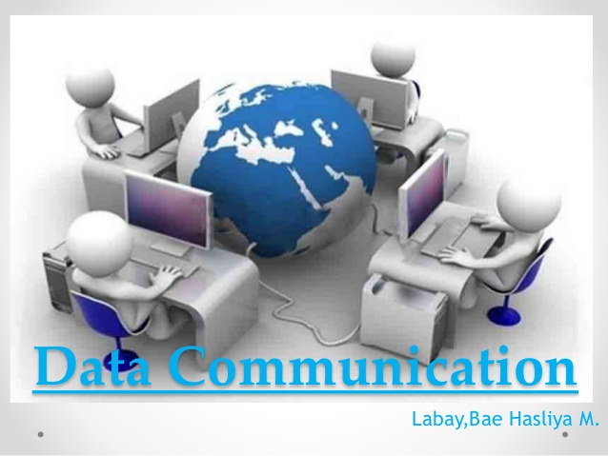
Unit 1 – Week 1
Session 1
Introduction to Data Communication and Networking
Data transfer modes-Serial and Parallel transmission
Session 2
Protocols & Standards
Layered Architecture
Session 3
Principles of Layering & Description
Brief description of concepts in OSI & TCP/IP model
Reference Text Books:
1. Behrouz A. Forouzan, “Data communication & Networking”, Mc-Graw Hill, 5th Edition Reprint, 2014.
2. Andrew S. Tanenbaum, “Computer Networks”, Pearson Education India, 5th Edition, 2013.

Slide 4
Introduction to Data Communication and Networking
Objectives :
To Introduce the students to data communication, networking and its fundamentals
To understand the concept of layered architecture
The main objective of data communication and networking is to enable seamless exchange of data between any two points in the world.
This exchange of data takes place over a computer network.

Slide 5
Introduction
Data & Information
Data refers to the raw facts that are collected while information refers to processed data that enables us to take decisions.
The word data refers to any information which is presented in a form that is agreed and accepted upon by is creators and users.
Data Representation
Data
Text
Image
Audio
Video
Numbers
Example:
When result of a particular test is declared it contains data of all students, when you find the marks you have scored you have the information that lets you know whether you have passed or failed.

Slide 6
Data Representation
Text
Combination of alphabets in small case/ upper case
Numbers
Combination of digits from 0 to 9.
Stored as a pattern of bits. Prevalent encoding system : ASCII, Unicode
Image
Video refers to broadcasting of data in form of picture or movie
Video can either be produced as a continuous entity, or it can be a combination of images in motion
Video
Audio
An image is composed of a matrix of pixels (picture elements).
Stored as a pattern of bits. Prevalent encoding system : ASCII, Unicode
Data can also be in the form of sound which can be recorded and broadcasted.
Audio data is continuous, not discrete.
Each pixel is assigned a bit pattern. The size and the value of the pattern depend on whether the image is binary, gray or color.

Slide 7
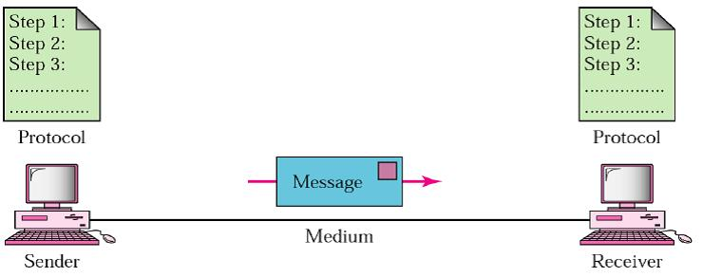
Data Communication and its Components
Data Communication is a process of exchanging data or information.
Components:
Message: Information/ data to be communicated. (texts, numbers, pictures, audio, and video)
Sender: Device that sends the data message. (video camera, computer, workstation, telephone handset, etc.)
Receiver: Device that receives the message. (TV, computer, workstation, telephone handset, etc.)
Transmission medium: Physical path by which a message travels from sender to receiver. (twisted-pair wire, coaxial cable, fiber optic cable, and radio waves).
Protocol: Set of rules that govern data communications between the communicating devices. ( Key elements of a protocol are syntax, semantics, and timing)
Without a protocol, two devices may be connected but not communicating.
Components of Data Communication Systems
In case of computer networks this exchange is done between two devices over a transmission medium.
This process involves a communication system which is made up of hardware and software.
Hardware part involves the sender and receiver devices and the intermediate devices through which the data passes.
Software part involves certain rules which specify what is to be communicated, how it is to be communicated and when. It is also called as a Protocol.

Slide 8
Characteristics of Data Communication
The effectiveness of any data communications system depends upon the following four fundamental characteristics
Characteristics of Data Communication
Delivery
Accuracy
Timeliness
Jitter
The data should be delivered to the correct destination and correct user.
Variation in the packet arrival time. Uneven Jitter may affect the timeliness of data being transmitted.
The communication system should deliver the data accurately, without introducing any errors.
The data may get corrupted during transmission. affecting the accuracy
Audio and Video data has to be delivered in a timely manner without any delay; such a data delivery is called real time transmission of data.

Slide 9
Data Transfer Modes
Data Transmission mode defines the direction of the flow of information between two communication devices. It is also called Data Communication or Directional Mode.
It specifies the direction of the flow of information from one place to another in a computer network.
Direction of exchange of information
Simplex
Full-Duplex
Synchronization between the transmitter and the receiver
Synchronous
Asynchronous
Number of bits sent simultaneously in the network
Serial
Parallel
Half-Duplex

Slide 10
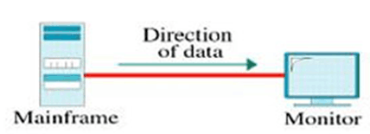
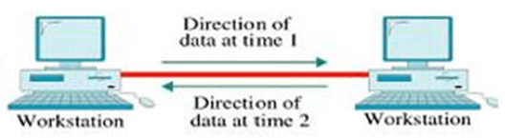

Data Transfer Modes: Exchange of Information
Simplex – data can flow only in one direction (unidirectional)
Half-Duplex or Semi-Duplex - data can flow in both directions but in one direction at a time.
Full-Duplex - data can flow in both directions at the same time. It is bi-directional in nature.
Ex: Radio and TV transmission, keyboard, mouse, monitor
Ex. Walkie-Talkie
Ex. Telephone Network,
Advantages:
* Facilitates the optimum use of the communication channel.
* Provides two-way communication.
Disadvantages
* Two-way communication cannot be established simultaneously at the same time.
* Delay in transmission may occur as only one way communication can be possible at a time.
Advantages:
* The two-way communication can be carried out simultaneously in both directions.
* Fastest mode of communication between devices.
Disadvantages
* The capacity of the communication channel is divided. Also, no dedicated path exists for data transfer.
Advantages:
* Utilizes full capacity of the communication channel
* No data traffic issues as data flows only in one direction.
Disadvantages
*Unidirectional- having no intercommunication between devices and no mechanism for acknowledging back to the sender.

Slide 11
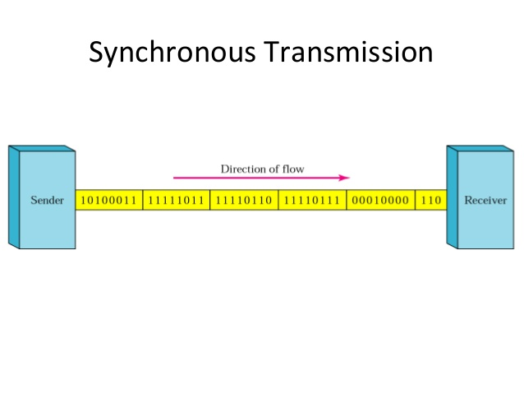
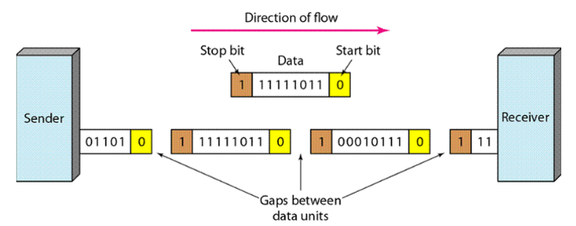
Data Transfer Modes: Synchronization
Synchronous Transmission:
Mode of communication in which the bits are sent one after another without any start/stop bits or gaps between them.
(Ex. communication in CPU, RAM )
Asynchronous Transmission:
Mode of communication in which a start and the stop bit is introduced in the message during transmission.
(Ex. Data input from a keyboard to the computer)
Advantages: Transmission speed is fast as there is no gap between the data bits.
Disadvantages : Very Expensive
Advantages: Cheap and effective mode of transmission.
Data transmission accuracy is high due to the presence of start and stop bits.
Disadvantages : Data transmission can be slower due to the gaps.
Notes:
Synchronous Transmission :
In this mode of transmission, both the sender and receiver are paced by the same system clock, thus synchronization is achieved.
In a Synchronous mode of data transmission, bytes are transmitted as blocks in a continuous stream of bits, as there is no start and stop bits in the message block. It is the responsibility of the receiver to group the bits correctly. The receiver counts the bits as they arrive and groups them in eight bits unit. The receiver continuously receives the information at the same rate that the transmitter has sent it. It also listens to the messages even if no bits are transmitted.
In synchronous mode, the bits are sent successively with no separation between each character, so it becomes necessary to insert some synchronization elements with the message, this is called "Character-Level Synchronization".
Asynchronous Transmission:
The start and stop bits ensure that the data is transmitted correctly from the sender to the receiver.
Generally, the start bit is '0' and the end bit is '1'.Asynchronous here means 'asynchronous at the byte level', but the bits are still synchronized. The time duration between each character is the same and synchronized.n
In an asynchronous mode of communication, data bits can be sent at any point in time. The messages are sent at irregular intervals and only one data byte can be sent at a time. This type of transmission mode is best suited for short-distance data transfer.

Slide 12
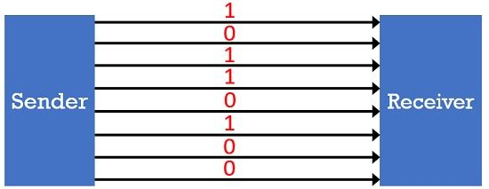
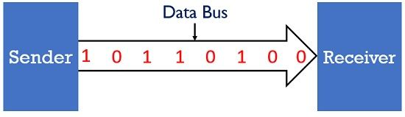
Data Transfer Modes: No. of bits Transmitted
Serial Transmission:
Mode of transmission in which the data bits are sent serially one after the other at a time over the transmission channel.
(Ex. Data transmission between two computers using serial ports )
Parallel Transmission:
Mode in which the data bits are sent parallelly at a time
(Ex. Data transmission between computer and printer.)
Advantages.
* long-distance data transmission as it is reliable.
* Number of wires and complexity is less.
* cost-effective.
Disadvantages : The Data transmission rate is slow due to a single transmission channel
Advantages:
Easy to program or implement.
Data transmission speed is high due to the n-transmission channel.
Disadvantages :
Requires more transmission channels, and hence cost-ineffective.
Interference in data bits, likewise in video conferencing.
Notes:
Serial Transmission:
Needs a single transmission line for communication.
In serial data transmission, the system takes several clock cycles to transmit the data stream.
In this mode, the data integrity is maintained, as it transmits the data bits in a specific order, one after the other.
Best suited for long-distance data transfer, or the amount of data being sent is relatively small.
Parallel Transmission:
Multiple transmission lines are used in such modes of transmission. So, multiple data bytes can be transmitted in a single system clock.
This mode of transmission is used when a l arge amount of data has to be sent in a shorter duration of time. It is mostly used for short-distance communication.
For n-bits, we need n-transmission lines. So, the complexity of the network increases but the transmission speed is high.
If two or more transmission lines are too close to each other, then there may be a chance of interference in the data, degrading the signal quality.

Slide 13
Selection of data transmission mode
Parameters need to be considered when selecting a data transmission mode:
Transmission Rate
The Distance that it covers
Cost and Ease of Installation
The resistance of environmental conditions

Slide 14
Review Questions
Q1. Communication between a computer and a keyboard involves ______________ transmission.
Q2. The information to be communicated in a data communications system is the ________.
Q3. In _______ transmission, the channel capacity is shared by both communicating devices at all times.
Q4. Computer Network is __________.
(a) Sharing of resources and information
(b) Collection of hardware components and computers
(c) Interconnected by communication channels
(d) All of the above
Q5. A _______ is the physical path over which a message travels.

Slide 15
Answers
1. Communication between a computer and a keyboard involves Simplex transmission.
2. The information to be communicated in a data communications system is the Message.
3. In full-duplex transmission, the channel capacity is shared by both communicating devices at all times
4. Computer Network is (option d: All the above)
5. A medium is the physical path over which a message travels.

Slide 16
Protocols
A protocol: the rules that both the sender and receiver and all intermediate devices need to follow to be able to communicate effectively.
When communication is simple, it needs only one simple protocol; when the communication is complex, it needs a protocol at each layer, or protocol layering
A protocol consists of a set of rules that govern data communications.
It determines what is communicated, how it is communicated and when it is communicated.
Key elements of Protocols
Semantics
Timing
Syntax
Interprets the meaning of the bits
Knows which fields define what action
Refers to the structure or format of the data, that is the order in which they are presented.
Refers to two characteristics: When data should be sent and how fast they can be sent
Notes:
A. Syntax
It means the structure or format of the data.
It is the arrangement of data in a particular order.
B. Semantics
It tells the meaning of each section of bits and indicates the interpretation of each section.
It also tells what action/decision is to be taken based on the interpretation.
C. Timing
It tells the sender about the readiness of the receiver to receive the data
It tells the sender at what rate the data should be sent to the receiver to avoid overwhelming the receiver.

Slide 17
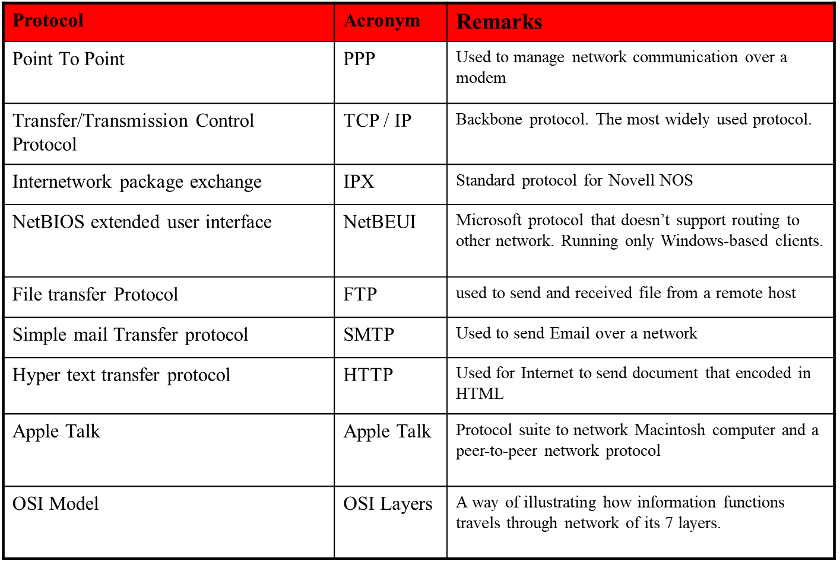
Common Protocols Used
.

Slide 18
Standards
Standards are necessary in networking to ensure interconnectivity and interoperability between various networking hardware and software components.
Concept of Standard
Standards provide guidelines to product manufacturers and vendors to ensure national and international interconnectivity.
Without standards we would have proprietary products creating isolated islands of users which cannot interconnect.

Slide 19
Standards
.
Data communications standards are classified into two categories:
1. De facto Standard
These are the standards that have been traditionally used and mean by fact or by convention
These standards are not approved by any organized body but are adopted by widespread use.
2. De jure Standard
It means by law or by regulation.
These standards are legislated and approved by an body that is officially recognized.

Slide 20
Standards Organizations in Networking Field
.
Standards are created by standards creation committees, forums, and government regulatory agencies.
Examples of Standard Creation Committees :
1. International Organization for Standardization(ISO)
2. International Telecommunications Union-Telecommunications Standard (ITU-T)
3. American National Standards Institute (ANSI)
4. Institute of Electrical & Electronics Engineers (IEEE)
5. Electronic Industries Associates (EIA)
Examples of Forums
1. ATM Forum
2. MPLS Forum
3. Frame Relay Forum
Examples of Regulatory Agencies:
Federal Communications Committee (FCC)

Slide 21
Layered Architecture
.
Computer networks are operated by network models; most prominently the Open System Interconnect Reference Model (OSIRM) and the TCP/ IP Model.
Concept of Layered Task
The main objective of a computer network is to be able to transfer the data from sender to receiver. This can be done by breaking it into small sub tasks, each of which are well defined.
Each subtask will have its own process or processes to do and will take specific inputs and give specific outputs to the subtask before or after it.
(In more technical terms we can call these sub tasks as layers)
In general, every task or job can be done by dividing it into sub task or layers.

Slide 22
Principles of Protocol Layering
.
Two principles of protocol layering.
The first principle dictates that if bidirectional communication, is required, then each layer is made responsible to perform two opposite tasks, one in each direction.
The second principle that to be followed in protocol layering is that the two objects under each layer at both sites should be identical.

Slide 23
Layered Architecture
.
Open System Interconnection Reference Model (OSIRM)
The OSIRM or OSI Model was developed by International Organization for Standardization (ISO).
ISO is the organization, OSI is the model.
It was developed to allow systems with different platforms to communicate with each other. Platform could mean hardware, software or operating system.
It is a network model that defines the protocols for network communications.
It is a hierarchical model that groups its processes into layers. It has 7 layers.
Each layer has specific duties to perform and has to cooperate with the layers above and below it.

Slide 24
Layered Architecture – OSI Layer
The OSI model has 7 layers each with its own dedicated task.. (Top to Bottom Layers)
Application Layer:
This layer is responsible for providing interface to the application user.
This layer encompasses protocols which directly interact with the user.
Presentation Layer:
This layer defines how data in the native format of remote host should be presented in the native format of host.
Session Layer: This layer maintains sessions between remote hosts.
Transport Layer: This layer is responsible for end-to-end delivery between hosts.
Network Layer:
This layer is responsible for address assignment and uniquely addressing hosts in a network.
Data Link Layer:
This layer is responsible for reading and writing data from and onto the line.
Link errors are detected at this layer.
Physical Layer: This layer defines the hardware, cabling wiring, power output, pulse rate etc.

Slide 25
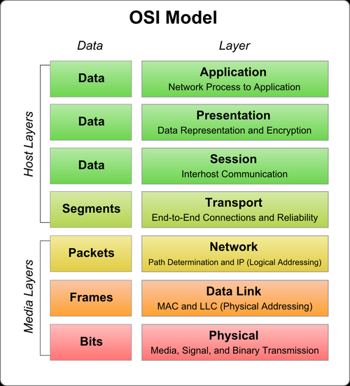
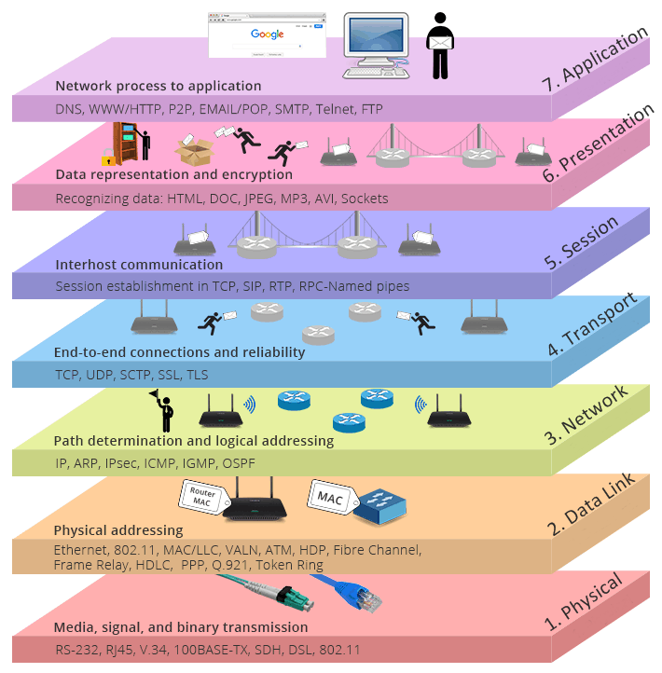
Layered Architecture – OSI Layer

Slide 26
Layered Architecture – OSI Layer
The responsibilities of the 7 layers of OSI model can be summarized as follows:
1. Application Layer To provide the users access to network resources
2. Presentation Layer To provide the functions of translation, encryption and compression.
3. Session Layer To establish, manage and terminate sessions
4. Transport Layer To provide process to process delivery of message
5. Network Layer To provide source to destination delivery of packets.
6. Datalink Layer To provide hop to hop delivery of frames
7. Physical Layer To transmit data over a bit stream from one hop to the next and provide electrical and mechanical specification.

Slide 27
TCP/IP PROTOCOL SUITE
The layers in the TCP/IP protocol suite do not exactly match those in the OSI model. The original TCP/IP protocol suite was defined as having four layers: host-to-network, internet, transport, and application. However, when TCP/IP is compared to OSI, we can say that the TCP/IP protocol suite is made of five layers: physical, data link, network, transport, and application.
Topics discussed in this section:
Physical and Data Link Layers Network Layer Transport Layer
Application Layer

Slide 28
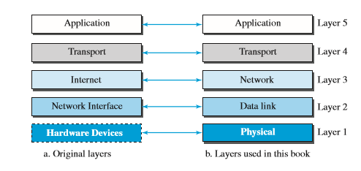
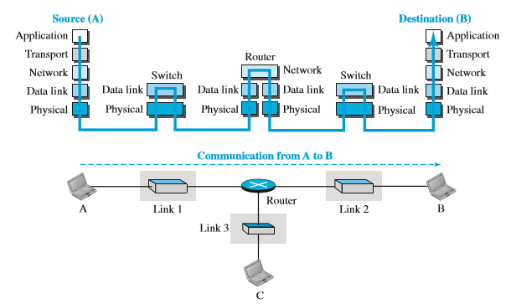
TCP/IP PROTOCOL SUITE

Slide 29
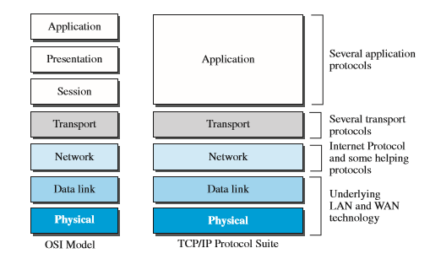
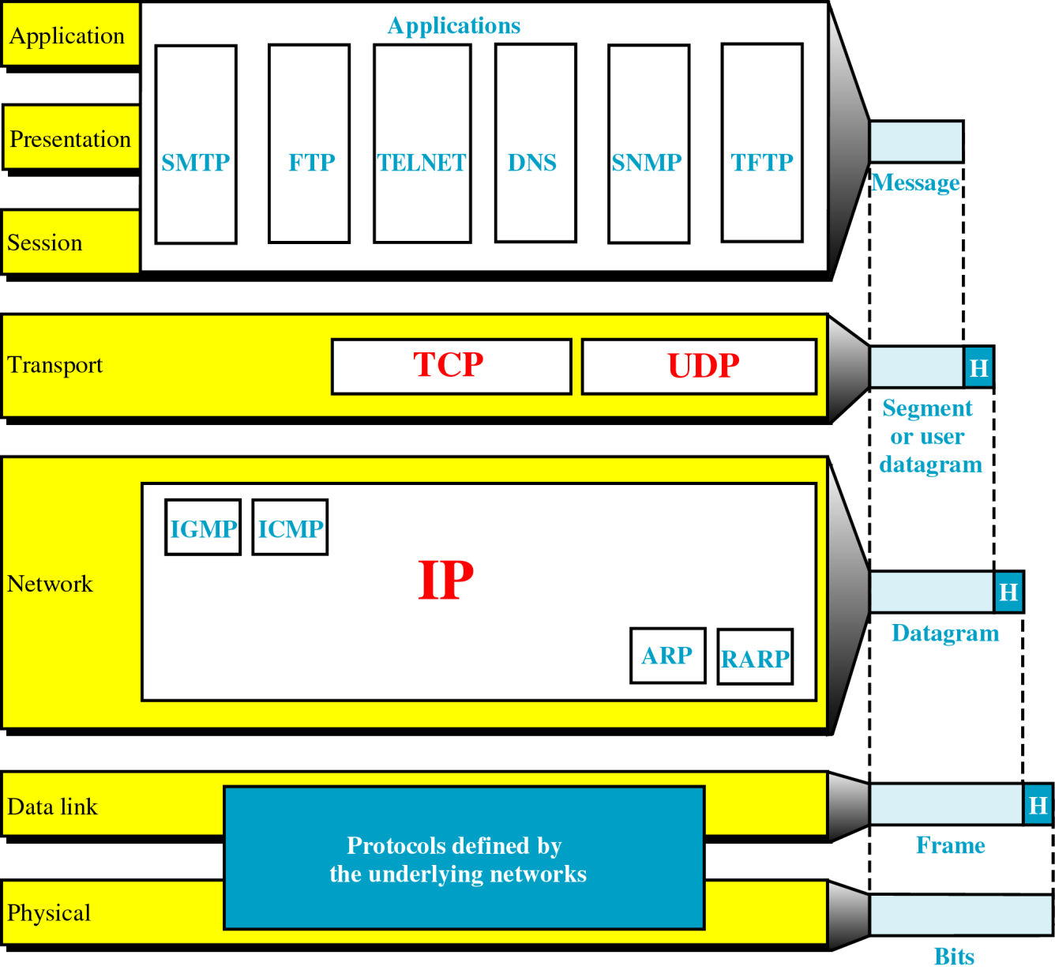
OSI versus TCP/IP

Slide 30
Review Questions
Q1. OSI Stands for ______________.
Q2. List the key components of a Protocol.
Q3. _____________ and ____________ are two categories of Standards.
Q4. Which of the following is true with respect to layered architecture?
a) Each layer is allowed to depend on the layer above it being present and correct
b) A layer may call other layers above and below it, as long as it uses them
c) All of the mentioned
d) None of the mentioned
Q5. What are the drawbacks for Layers?
a) It is often necessary to pass data through many layers, which can slow performance significantly
b) Layers support information hiding
c) Multi-layered programs can be hard to debug because operations tend to be implemented through a series of calls across layers
d) None of the mentioned

Slide 31
Answers
1. Open System Interconnection.
2. Syntax, Semantic and Timing.
3. De facto Standard and De Jure Standard
4. Option d: None of the above mentioned
5. Multi-layered programs can be hard to debug because operations tend to be implemented through a series of calls across layers

